Slide 1
UAE University E-book Access

Slide 2
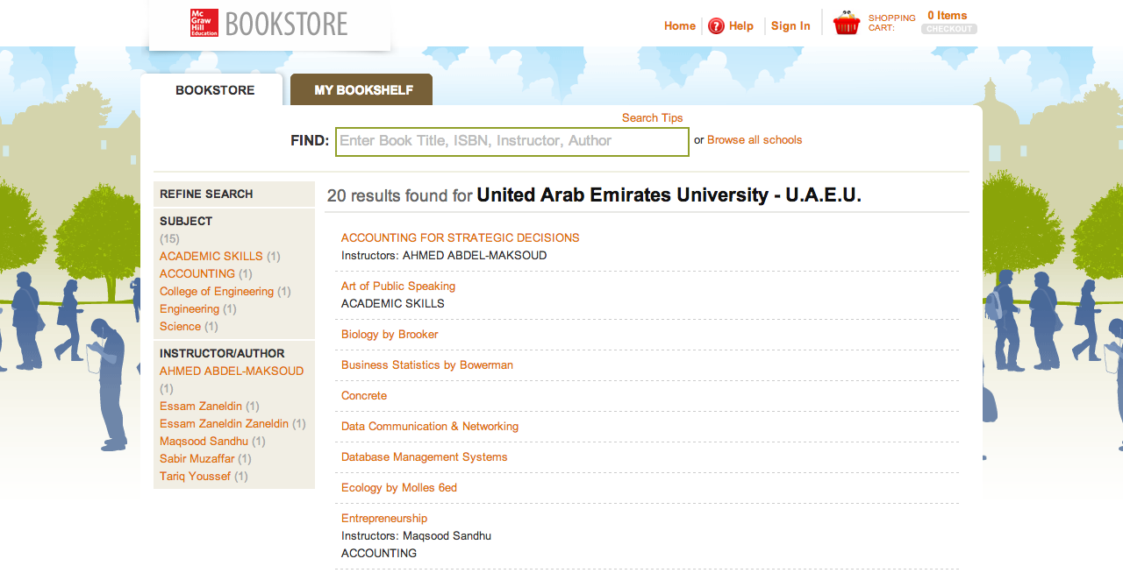
Visit: http://tinyurl.com/o3hvaky & click the desired course
Notes:
Scroll through the pages to find the book which needs to be downloaded.

Slide 3
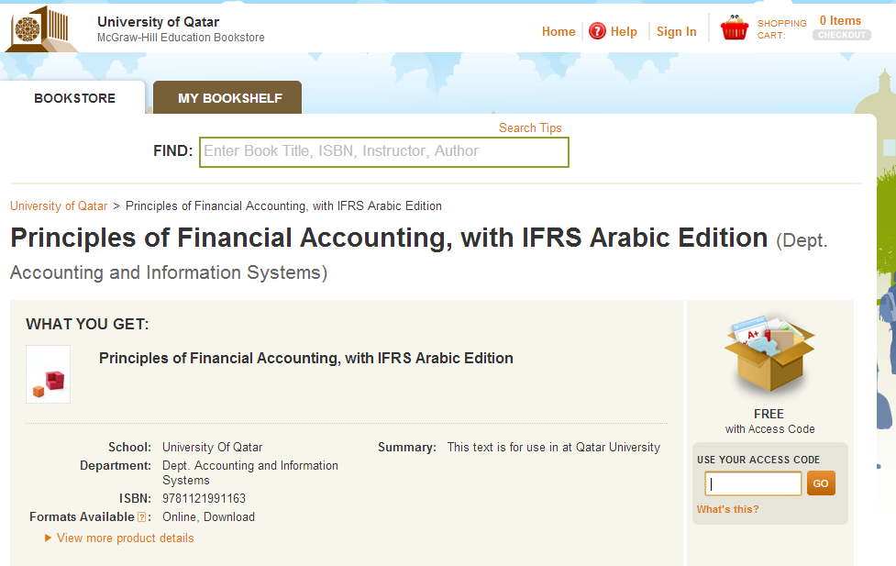
Enter Redemption Code & Click “Go”
(DO THIS STEP ONLY ONE TIME FOR EACH EBOOK)

Slide 4
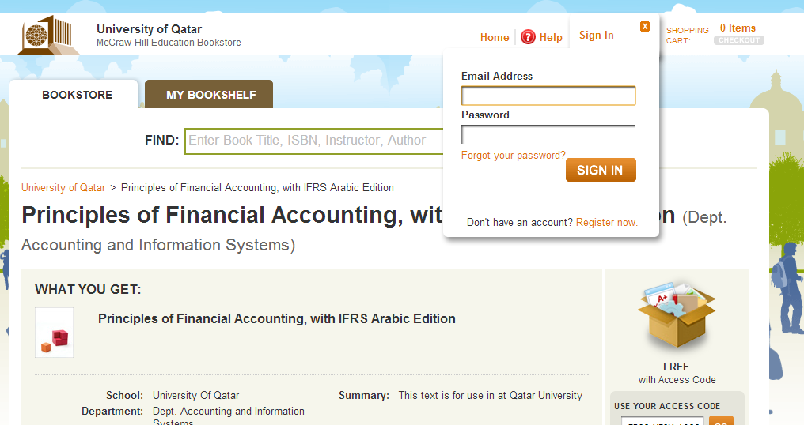
FIRST TIME USER: Click “Register Now”
EXISTING USER: Input Email & Password & Click “Sign In”

Slide 5
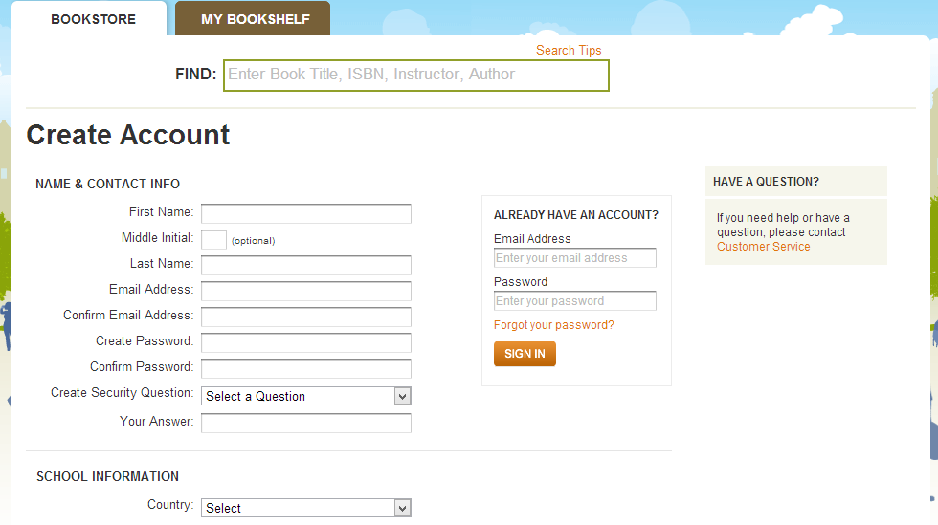
Fill in the Registration Form, Agree to the T&C & Click “Submit”
REMEMBER THE EMAIL & PASSWORD USED IN THIS STEP AS THIS WILL BE REQUIRED FOR ANY FUTURE ACCESS TO THE E-BOOK

Slide 6
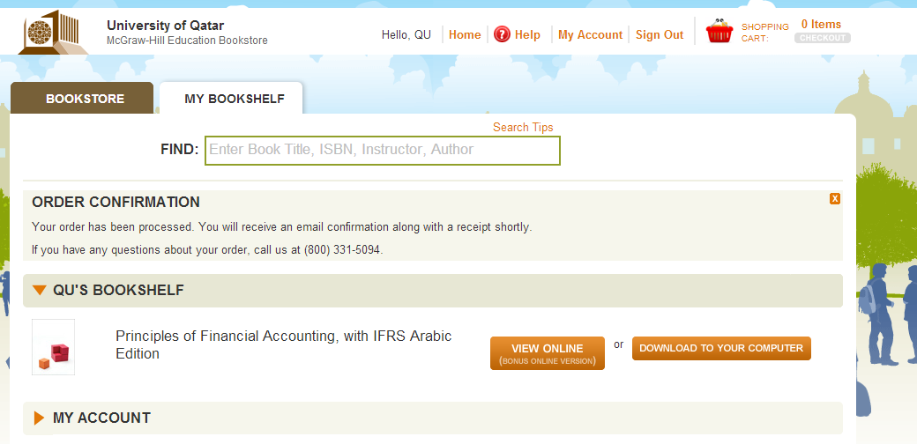
Ebook is now Redeemed & Instant Online Access is Granted
To Download an Offline Copy to a Laptop/Desktop
Click “Download To Your Computer”

Slide 7
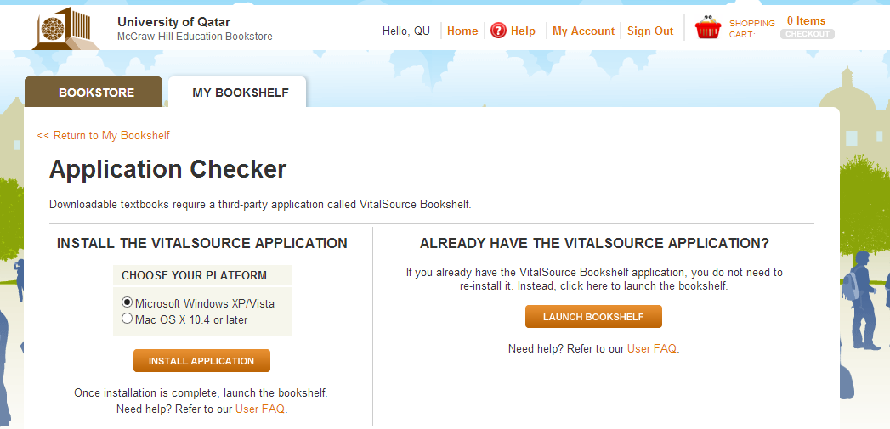
Select the Appropriate Platform & Click “Install Application”
Once Installed - Sign In one time only to the Offline Reader with the Same Email & Password Created in the Earlier Registration Step

Slide 8
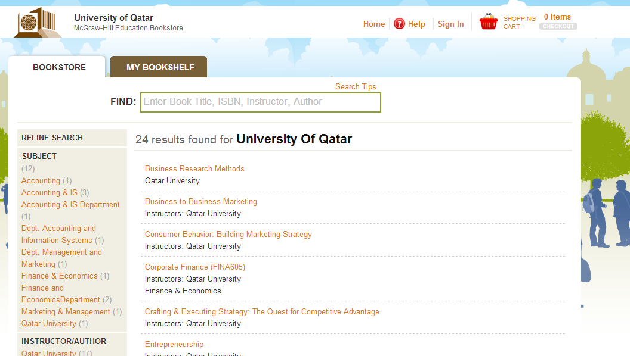
For Future Online Access to the Same E-Book Already Redeemed, Visit: http://tinyurl.com/o3hvaky & Click “Sign In”

Slide 9
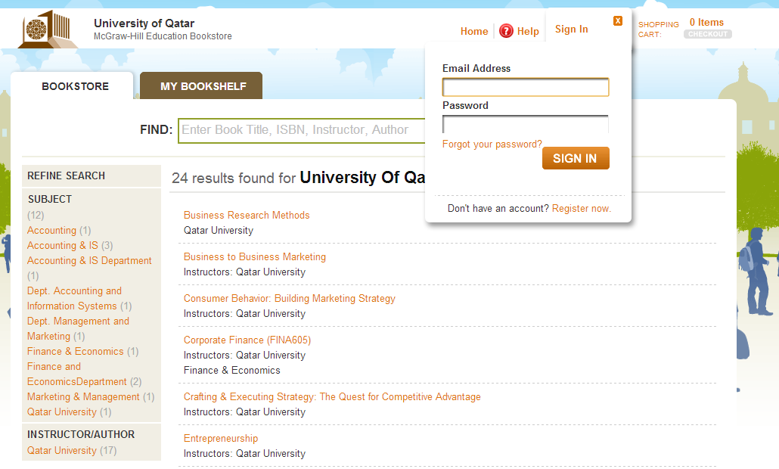
Input the Email & Password from the Earlier Registration Step & Click “Sign In”

Slide 10
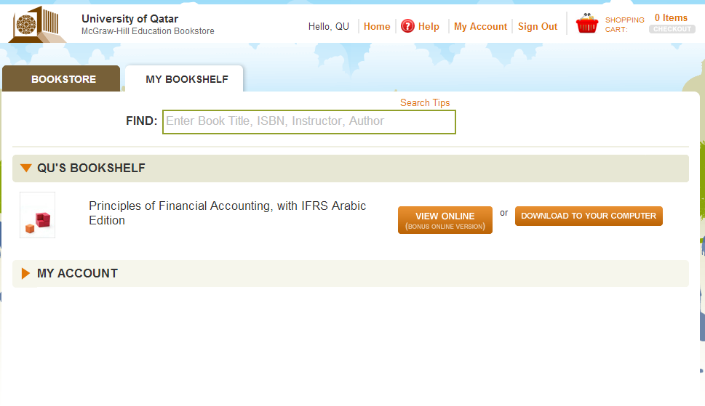
Ebook is Now Available in Your Bookshelf for viewing

Slide 11
TABLET ACCESS (IPAD/ANDROID)
In the App Store, Search & Download “VitalSource Bookshelf”
Once Downloaded Onto Your device, Launch the App & Sign in (One Time Only) with the Email & Password Created in the Previous Ebook Registration Step
The First Time an E-Book is Accessed it Needs to be Downloaded. This Step May Take Some Time & Requires an Internet Connection. This is a “One Time Only” Requirement & in the Future You Will Have Instant & Offline Ebook Access

