Slide 1

Department of Agribusiness and Consumer Sciences
قسم الادارة الزراعية وعلوم المستهلك

Slide 2
What is the Department of Agribusiness and Consumer Sciences?
Agribusiness emphasize the application of both business and economic principles to the practical subjects relevant to the agricultural and food sectors and their stakeholders
( government, companies, farmers, and the consumers)
Subjects covered in the department include agribusiness:
  Administration
  Marketing (buying, shipping, advertisement, imports and exports, and sales..)
  Investment and finance
  Management
  Strategies and planning
  Control and evaluation
قسم الادارة المزرعية وعلوم المستهلك يركز على تطبيقات مبادئ الادارة والاقتصاد فى ما يتعلق بموضوعات تخص قطاعى الزراعة والغذاء
وتهدف الى رفاهية وكفاءة كل من له علاقه بهذين القطاعين الهامين

Slide 3
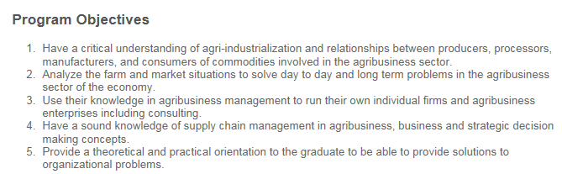
Department of Agribusiness Objectives
يهدف البرنامج الى تخريج اكفاء قادرين على فهم و تحليل وتطبيق اسسس علميه وتطبيقية وادارية فى ما يتعلق بنظام تخطيط وانتاج توزيع وتصدير واستيراد المواد الزراعية والغذائيه فى ظل عالم مترابط ومتنامى وحساس فى ما يتعلق بالموارد الطبيعية والغذاء

Slide 4

Agribusiness department graduation requirements
Required credit: 120 credit hours
  General Education: 21 credit hours
  College Requirements: 12 credit hours
  Agribusiness Department Required Courses: 60 hours
  Elective Courses: 21 credit hours –
  select from 12 courses
  Free Electives: 6 credit hours (2 courses) مساقين اختياريين من كل الجامعه
اجمالى الساعات الدراسيه
متطلب الجامعه: ساعات الثقافه العامة
متطلب الكليه: رياضيات ، فيزياء أحياء، واحصاء
متطلبات قسم الادارة المزرعية بما فيها دوره تدريبيه ميدانية و مشروع التخرج
مساقات التخصص الاختيارية (7 مواد من ضمن 12 مادة تطرح)

Slide 5
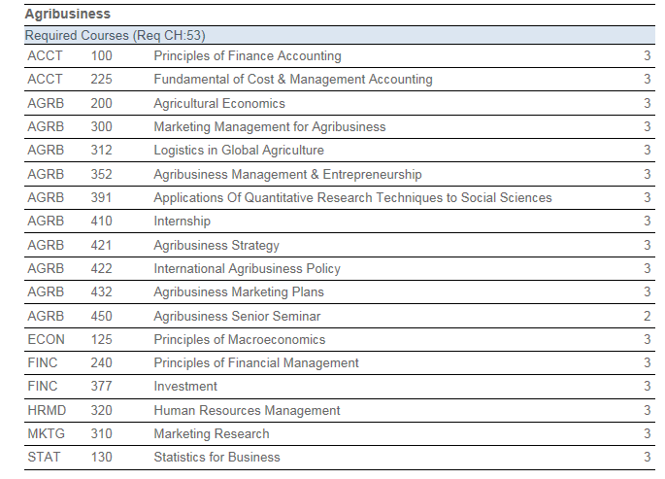
Examples from Courses المساقات الدراسية

Slide 6
Where Agribusinesses Dept. Graduates have Worked ?
Government (Federal Ministries, Municipalities, Food and Control Authority, Farmers Services Agency, …. e.g. Ministry of Water and Environment, Abu Dhabi Food Control Authority, Abu Dhabi Farmers Services, Dubai Municipality ….
Farm Managers
Universities and other education institutions
Private Sector (Tourism, Food Processing, Banks, Airlines)
Consulting service (intentional and local)
Start your own agribusiness firm
فرص العمل ومواصلة الدراسات العليا

Slide 7

Agribusiness Department is Internationally Accredited
Agribusiness undergraduate program is internationally accredited by the Agricultural Institute of Canada (AIC) in 2009.
This is important because it will enable more department graduates to:
  Pursue jobs at local, regional, and international organizations
  Pursue graduate degrees (Master and PhD) at our university, other UAE universities and or travel overseas to pursue degree at well recognized universities
  Start and or join global corporations around the world
برنامج الادارة المزرعية معترف به دوليا

