Slide 1
Students Orientation
Nutrition and Health Department

Slide 2
DNH
Department Mission
Promote, protect, and improve the nutritional wellbeing and health of individuals, families, and communities in the UAE through high quality education, research, and outreach programs in human nutrition.

Slide 3
DNH
Academic Program
Two Undergraduate Programs
  Bachelors Degree in Dietetics
  Bachelors Degree in Nutritional Science
PhD Program in Nutritional Sciences

Slide 4
DNH
Dietetics
The Coordinated Program in Dietetics is accredited by the Accreditation Council for Education in Nutrition and Dietetics (ACEND), USA.
The CPD program is the first program in the UAE and the fifth program outside the USA to be accredited:
http://www.eatrightacend.org/ACEND/content.aspx?id=6442485488
Notes:
The Dietetics major prepares graduates to work in the applied field of dietetics in such as clinical dietitians, nutrition services managers, nutrition educators, and community dietitians.

Slide 5
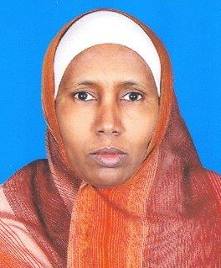
DNH
Dietetics
CPD Program Coordinator
Dr. Habiba Ali

Slide 6
DNH
Nutritional Science
The Nutritional Science major provides students with a solid understanding of the key role that diet plays in the prevention, development and treatment of most major diseases.
The program also emphasizes basic sciences for students planning further studies in health-related professions such as medicine, nursing, or physical therapy.
Notes:
This major prepares graduates to work as nutrition educators, public health nutritionists, health professionals, and nutrition researchers.

Slide 7
DNH
Nutritional Science
The Department is currently working towards accrediting the Nutritional Science Program from the Association For Nutrition (AFN) – United Kingdom.
Accreditation expected NEXT year

Slide 8
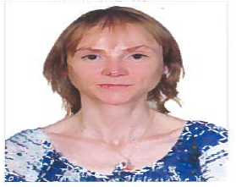
DNH
Nutritional Science
NS Program Coordinator
Dr. Carine Platat

Slide 9
DNH
PhD Program in Nutritional Sciences
The Department established a PhD program in Nutritional Sciences in Fall 2010.
The program was approved by the UAEU Board of Graduate Studies.

Slide 10
DNH
Inclusion Criteria for Scientific Programs
Not more than 20 CH of courses
Dietetics Program | Nutritional Science Program
GPA = > 3.0 | GPA = > 2.4
Introductory Biology (Grade C) | Introductory Biology (Grade C)
General Chemistry I (Grade C) | General Chemistry I (Grade C)

Slide 11
DNH
Future Career for Dietitians
Clinical dietitians
Provide medical nutrition therapy
Hospitals, outpatient clinics, private practice
Foodservice Management Dietitians
Foodservice administration
Community Dietitians
Schools
Public Health Settings
Industry/business
Sports nutrition
Corporate wellness programs
Dietitians in Research and Academia

Slide 12
DNH
Future Career for Nutritionists
Research Nutritionist
Governmental institutions (food and health authorities): administrative role, laboratory, research, education/communication
Food , pharmaceutical and nutrition-related companies: research, packaging, labeling, laboratory
Public Health nutritionist: to aid in diagnosing the nutritional problems of communities and in finding solutions, to develop wellness programs for populations
Sport nutritionist: to aid in diagnosing nutritional problems among athletes and/or active people and in counseling for health, performance and safety
Business Nutritionist: to be a resource person for media
Education Nutritionist: to develop tools, training, workshops for health professionals or non-professionals

Slide 13
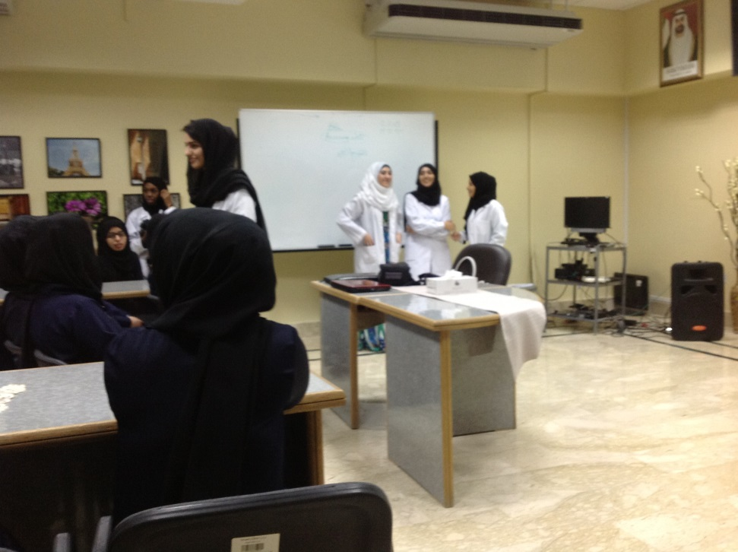
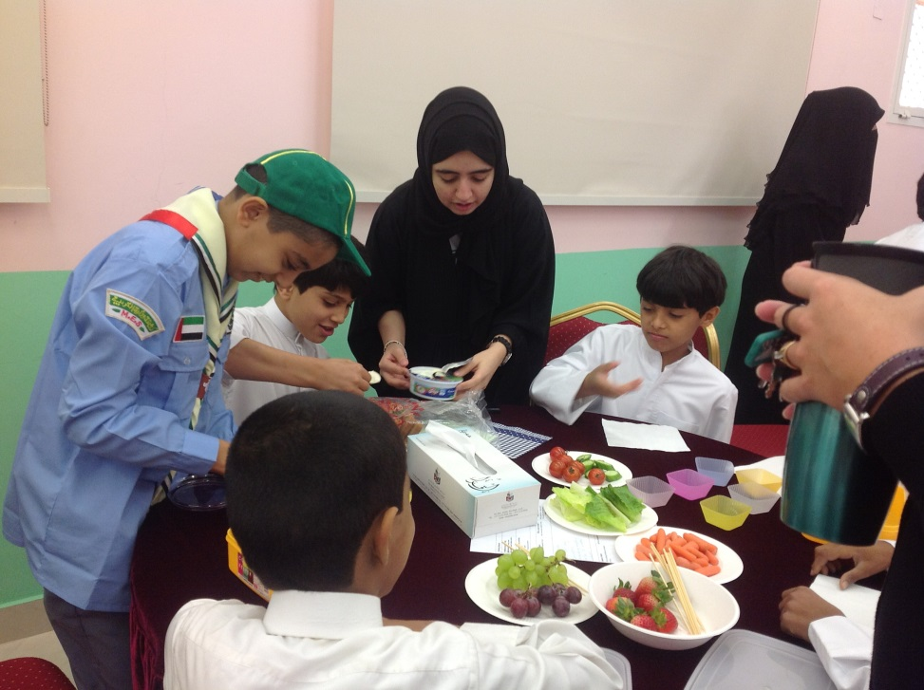
Students Involvements Nutrition Education in Schools
Educating Secondary School Students
Educating Primary School Children

Slide 14
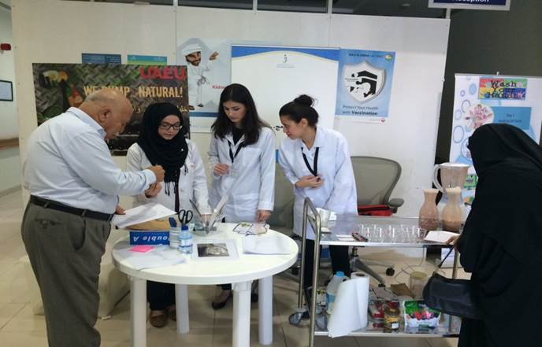

Students Conducting Nutrition Education

Slide 15
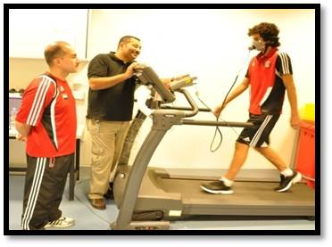
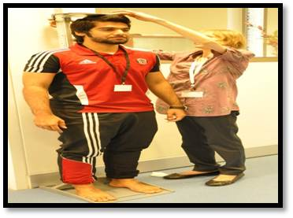
Practical activity in Sport Nutrition Course

Slide 16
Thank You

