Slide 1

The Sustainable
Development
Goals
Reality & Prospects
Mahmoud Mohieldin, Senior Vice President
World Bank Group
Mahmoud Mohieldin
March 13th, 2017

Slide 2
Global
Context
Notes:
After reaching a post-crisis low of 2.3 percent, global growth is expected to recover to 2.7 percent in 2017, mainly supported by stronger growth in EMDEs. Growth in commodity exporters is expected to pick up, while growth in commodity importers is projected to remain robust. Downside risks to global growth still dominate. They are associated with heightened policy uncertainty, protectionist pressures, and risk of financial market disruptions. A prolonged period of elevated policy uncertainty could weigh on EMDE investment growth. In turn, weak investment could adversely affect productivity growth, which has slowed considerably in the post-crisis period.

Slide 3
Global Economy
GDP Growth (Percent)
Source: World Bank.
Notes:
After reaching a post-crisis low of 2.3 percent, global growth is expected to recover to 2.7 percent in 2017, mainly supported by stronger growth in EMDEs. Growth in commodity exporters is expected to pick up, while growth in commodity importers is projected to remain robust. Downside risks to global growth still dominate. They are associated with heightened policy uncertainty, protectionist pressures, and risk of financial market disruptions. A prolonged period of elevated policy uncertainty could weigh on EMDE investment growth. In turn, weak investment could adversely affect productivity growth, which has slowed considerably in the post-crisis period.

Slide 4
Regional Economy
GDP Growth (Percent)
Source: World Bank.
Notes:
After reaching a post-crisis low of 2.3 percent, global growth is expected to recover to 2.7 percent in 2017, mainly supported by stronger growth in EMDEs. Growth in commodity exporters is expected to pick up, while growth in commodity importers is projected to remain robust. Downside risks to global growth still dominate. They are associated with heightened policy uncertainty, protectionist pressures, and risk of financial market disruptions. A prolonged period of elevated policy uncertainty could weigh on EMDE investment growth. In turn, weak investment could adversely affect productivity growth, which has slowed considerably in the post-crisis period.

Slide 5
Looking Back: The MDGs Era
MDG 1.1: Poverty
MDG 1.9: Malnourishment
MDG 2.2: Primary Completion
MDG 3.1: Gender Parity
MDG 4.1: Under-5 Mortality
MDG 4.2: Infant Mortality
MDG 5.1: Maternal Mortality
MDG 7.8: Water
MDG 7.9: Sanitation
Notes:
Estimates for the developing world indicate that the targets for extreme poverty reduction (MDG 1.a), access to safe drinking water (MDG 7.c) and improving the lives of at least 100 million slum dwellers (MDG 7.d) have been reached ahead of the 2015 deadline (figure 1). The targets on gender equality in primary and secondary education (MDG 3.a) and the incidence of malaria (MDG 6.c) can be met by 2015. Note that gender disparity in primary education was met in 2010.
On the other hand, progress on the remaining MDGs has been lagging, especially for education and health-related MDGs. Specifically, the primary school completion rate reached 90 percent by 2012, but progress is off track to meet the target of a universal completion rate by 2015. Progress toward MDGs related to infant, child, maternal mortality (MDGs 4a and 5a), and access to basic sanitation (MDG 7c), is lagging, and these goals are unlikely to be achieved.
The heterogeneity of outcomes at the country level translates into stark differences in progress towards the MDGs at the regional level. At one end of the spectrum, the East Asia and Pacific region is estimated to have met all of the MDGs, while at the other end Sub-Saharan Africa is off target on most of its MDGs. The regions still lagging, in particular South Asia and Sub-Saharan Africa, started from positions that required the most improvement, however, and they have made significant progress in absolute terms, particularly on the health MDGs that the world as a whole is struggling to meet. The relative nature by which many of the MDGs are defined tends to mask significant accomplishments in South Asia and Sub-Saharan Africa

Slide 6
Progress on Child & Maternal Mortality

Slide 7
Global Frameworks for Development:
From MDGs to SDGs
 | MDGs (2000-2015) | SDGs (2016-2030)
Goals | 8 | 17
Targets | 21 | 169
Indicators | 60 | ~231
Priority Areas | Human Development | Holistic: Economic, Social, Environmental
Scope | Developing Countries | Universal
The global development agendas serve as a compass and guide for countries to determine their national development path

Slide 8
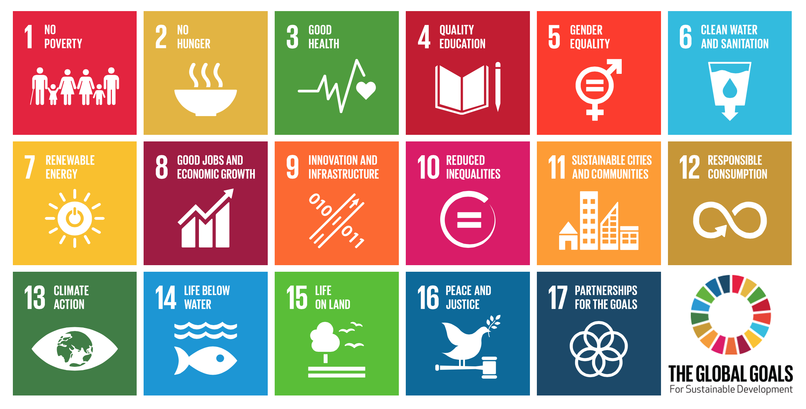
The Sustainable Development Goals
The 2030 Agenda of Ending Poverty, Preserving the Planet, While Leaving No One Behind

Slide 9
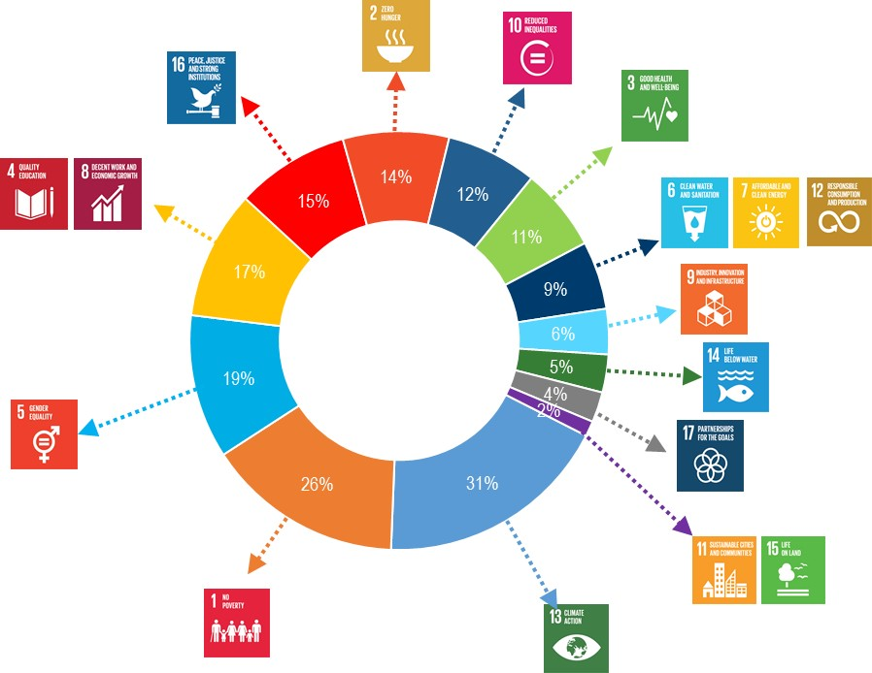
Alignment of Countries to
the Sustainable Development Goals
84 governments presented their plans on achieving the SDGs*:
Country development strategy aligned
Institutional structures aligned
PRIORITY GOALS HIGHLIGHTED BY COUNTRIES:
*based on analysis of statements made at April 21 UN HLTD event on SDG implementation

Slide 10
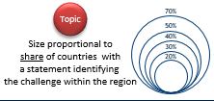
Conflicts, Climate Change, Financing, Data
Most Frequently Identified Challenges
Lack capa-city
Conf-licts
Lack of data
CC
Climate change
Trade restric-tions
Pop. displa-cement
Conflicts
violence
Climate change
Lack data
Violence/ extremism
Lack of fin
Lack data
Lack fin.
Lack capa-city
Clim. change
Lack data
Viol-ence
Lack of capacity
Conflicts
Environ-ment
Climate change
Conflicts
Lack of capacity
Lack of capacity
Environment
Climate change
Lack of financing
Lack of financing
* Based on analysis of statements made on April 21, 2016 during the High-Level Thematic Debate (HLTD) event held at United Nations. Statements available online: https://papersmart.unmeetings.org/ga/70th-session/high-level-thematic-debate-on-achieving-the-sustainable-development-goals/statements/

Slide 11
WBG Areas For Action To Support The 2030 Agenda
FINANCING
DATA
IMPLEMENTATION
Domestic resource mobilization; leveraging private sector; addressing needs of regional and global public goods
Ensure availability of household budget surveys in 78 poorest countries every three years; data revolution; statistical capacity building
Country engagement model; Draw on strength of entire WBG to provide integrated solutions
WBG action on the SDGs has been articulated along these three focus areas

Slide 12
Financing

Slide 13
Critical Components Of Financing For Development
1. National public resources: | Improving domestic resource mobilization (DRM)
2. Global public resources: | Better and smarter aid
3. National and global private resources: | Unlocking private investment for development, Attracting FDI, Remittances, Philanthropic finance
The World Economic Forum estimated that annual demand for infrastructure finance alone is $3.7 trillion. With annual investment currently around $2.7 trillion, this leaves a gap of $1 trillion per year.
According to the Global Commission on the Economy and Climate, incorporating climate considerations raises the financing gap even further, to $2-3 trillion per year.

Slide 14
1. Domestic Resources
A country’s ability to mobilize domestic resources (DRM) and spend them effectively – at the national, sub-national and municipal levels –lies at the crux of financing for development.
Strengthening the capacity of local governments, including to raise their own revenues, to manage expenditures and service delivery, and to borrow and manage debt prudently is critical;
Developing inter-government fiscal transfer arrangements that consider the needs of sub-national governments and equalize fiscal capacity and expenditure is also critical
Source: IMF data
Notes:
1. DOMESTIC RESOURCES ARE the largest resource available for development

Slide 15
2. Official Development Assistance
As development challenges at the global and national levels increase, so too should the resource envelope available to meet these needs….ODA flows are simply not enough.
ODA: Official Development Assistance. ODA in the chart includes bilateral ODA and multilateral concessional flows.
Non-ODA flows include: other official developmental flows, officially-supported export credits, FDI, other private flows at market terms and private grants.
Adjusted gross disbursements, three-year moving average, USD million, 2012 constant prices.
Sources. Remittances, World Bank. Other resource flows, DAC statistics. NB: Data on flows to MADCTs are only available up to 2010.

Slide 16
3. Mobilizing Private Resources
As development challenges at the global and national levels increase, so too should the resource envelope available to meet these needs….
Aggregate assets held by ten largest MDBs: $1.3 trillion
Making the “Billions to Trillions” pledge a reality requires expanding the pool of development capital beyond the multilateral development banks (MDBs) and official agencies.
Private funds:
    $2 trillion of assets held by the world’s ten largest pension funds
    $4.5 trillion of assets held by the world’s ten largest insurance companies
  $5 trillion in assets held by the world’s ten largest sovereign wealth funds
  $100 trillion global bond market
The global community looks to the World Bank Group to lead on the “Billions to Trillions” initiative - a call to greatly increase the financial capacity that can be deployed to meet the Sustainable Development Goals.
Notes:
To scale up its impact , the WB will need to invest in new approaches and instruments to leverage external resources. The Bank has a key role to play in the mobilization of private capital for development because money alone is not the answer: to be optimally utilized, private capital flows to our member countries must come with the right governance, environmental and social infrastructure.

Slide 17
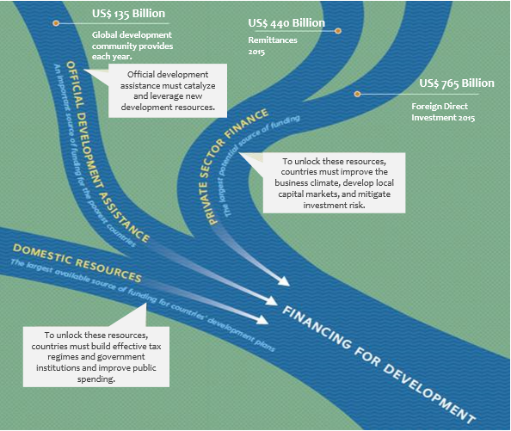

Slide 18
Sustainable Finance
The Cascade
1
COMMERCIAL FINANCING
Can commercial financing be cost-effectively mobilized for sustainable investment? If not…
UPSTREAM REFORMS
& MARKET FAILURES
  Country and Sector Policies
  Regulations and Pricing
  Institutions and Capacity
2
Can upstream reforms be put in place to address market failures? If not…
PUBLIC AND CONCESSIONAL
RESOURCES FOR RISK INSTRUMENTS
& CREDIT ENHANCEMENTS
  Guarantees
  First Loss
3
Can risk instruments & credit
enhancements cost-effectively
cover remaining risks? If not…
PUBLIC & CONCESSIONAL FINANCING,
INCLUDING SUB-SOVEREIGN
  Public finance (incl. national development banks and domestic SWF)
  MDBs and DFIs
Can development objectives be resolved with scarce public financing?
4

Slide 19
Data
Notes:
After reaching a post-crisis low of 2.3 percent, global growth is expected to recover to 2.7 percent in 2017, mainly supported by stronger growth in EMDEs. Growth in commodity exporters is expected to pick up, while growth in commodity importers is projected to remain robust. Downside risks to global growth still dominate. They are associated with heightened policy uncertainty, protectionist pressures, and risk of financial market disruptions. A prolonged period of elevated policy uncertainty could weigh on EMDE investment growth. In turn, weak investment could adversely affect productivity growth, which has slowed considerably in the post-crisis period.

Slide 20
Good Data Informs Implementation
  Improving data availability
Statistical Capacity Score (scale: 0-100)
19
Notes:
The Statistical Capacity Indicator provides an overview of the capacity of a country's national statistical system based on a diagnostic framework thereby assessing three dimensions: Methodology, Source Data, and Periodicity and Timeliness.

Slide 21
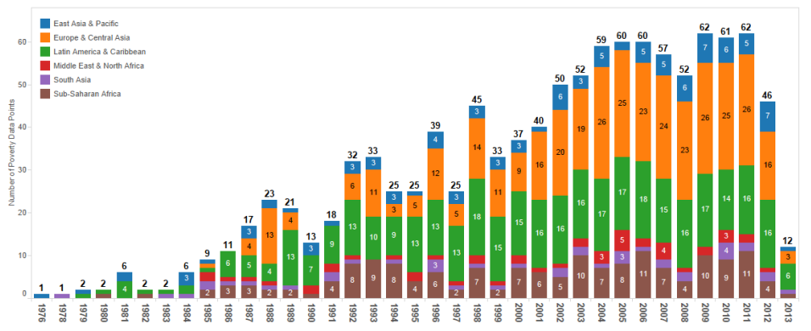
Good Data Informs Implementation
  Improving data availability
Number of Poverty Data since 1976
20
Notes:
Counting the number of poverty estimate per year is a useful exercise to assess data availability, but to assess a country’s ability to monitor poverty and shared prosperity, the frequency of poverty data matters. For example, to grasp whether poverty in a country is rising or declining, at least two data points within a ‘reasonable’ time interval are required.
57 countries have 0-1 poverty data points

Slide 22
Implementation

Slide 23
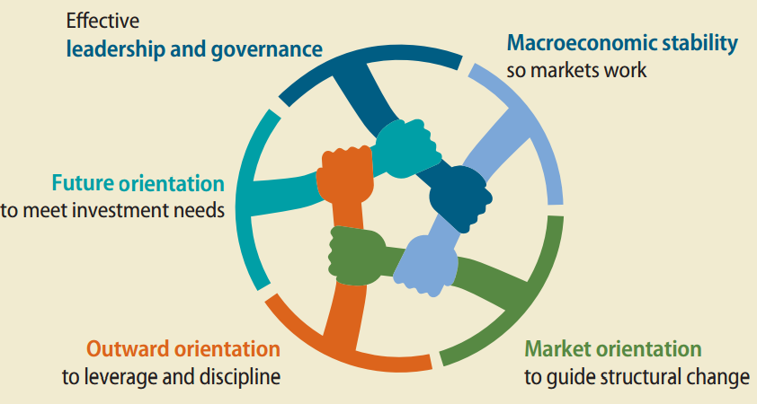
Key Areas for Countries to Unlock their Implementation Potential
  Growth for poverty reduction – five common characteristics
Accumulation
Future orientation
High investment
High saving
Stabilization
Macroeconomic stability
Modest inflation
Sustainable public finances
Inclusion
Leadership and governance
Credible commitment to growth
Credible commitment to inclusion
Capable administration
Innovation
Openness
Import knowledge
Exploit global demand
Allocation
Market Allocation
Prices guide resources
Resources follow prices
22

Slide 24
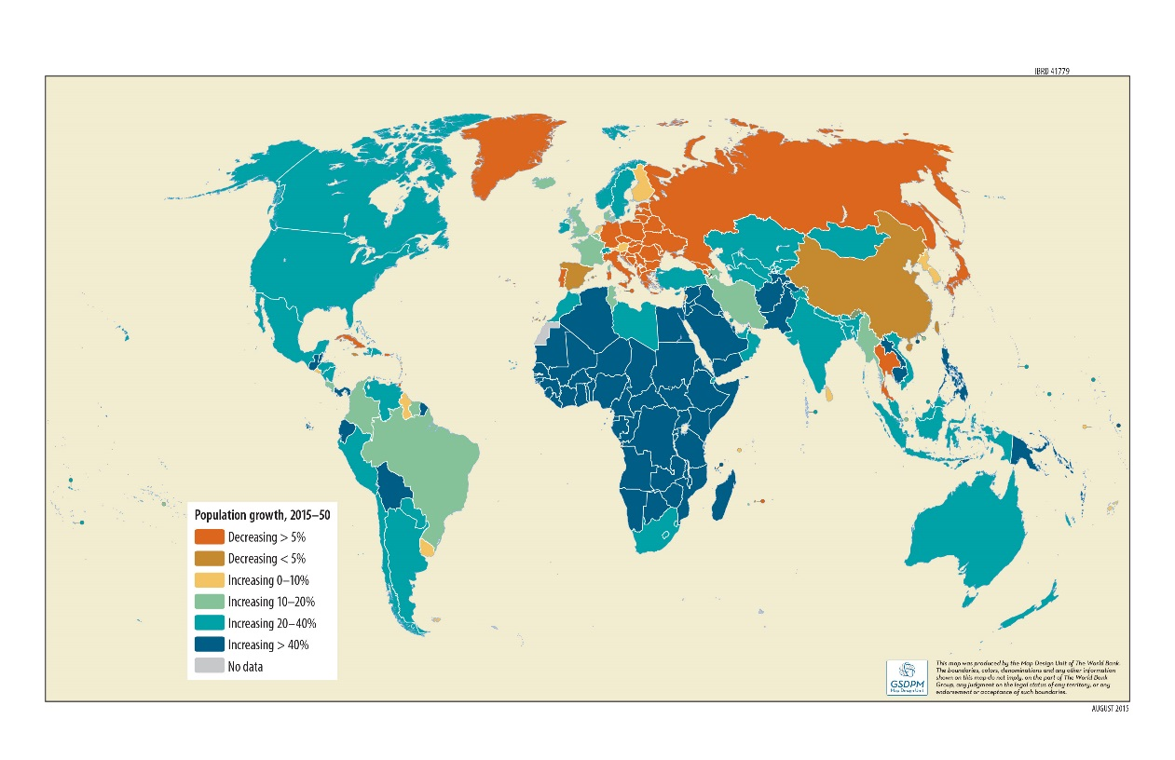
Key Areas for Countries to Unlock their Implementation Potential
  Harnessing the Demographic Transition
Cumulative change in population, 2015-50
23

Slide 25
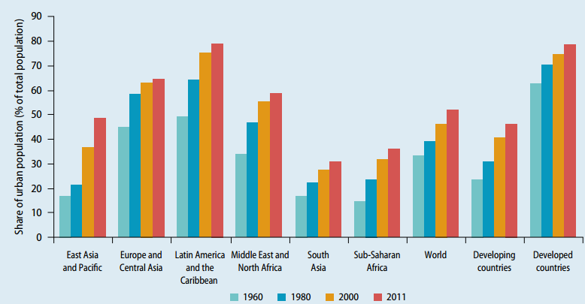
Key Areas for Countries to Unlock their Implementation Potential
  Managing Urbanization: 96% of increase in developing country population between now and 2030 will be in urban areas
Share of Urban Population (% of total)
24

Slide 26
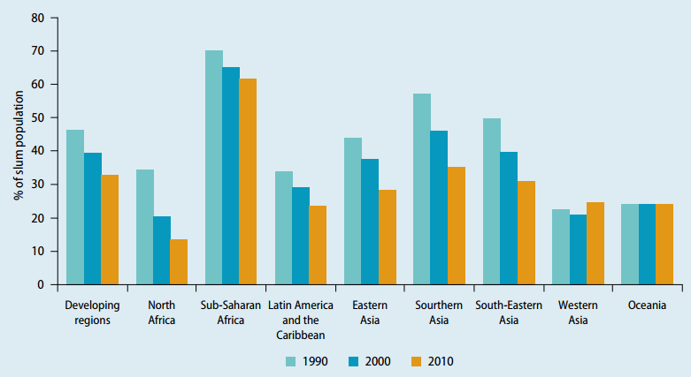
Key Areas for Countries to Unlock their Implementation Potential
  Managing urbanization
Proportion of urban population living in slums, 1990–2010
25

Slide 27
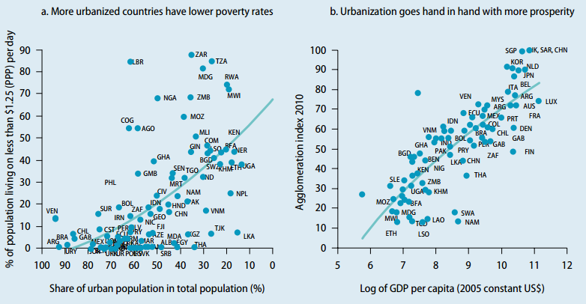
Key Areas for Countries to Unlock their Implementation Potential
  Managing urbanization
26

Slide 28
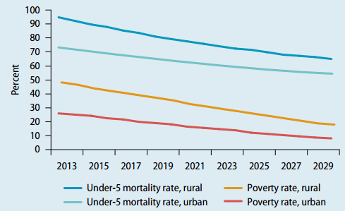
Key Areas for Countries to Unlock their Implementation Potential
  Managing urbanization
Poverty and under-5 mortality for base simulation
27

Slide 29
Key Areas for Countries to Unlock their Implementation Potential
  Managing urbanization
Connect:
Value the city’s external and internal connections
Coordinate among transport options and with land use
Leverage investments that will generate the largest returns— individually and collectively
Plan:
Value land use through transparent assessment
Coordinate land use with infrastructure, natural resources, and hazard risk
Leverage competitive markets alongside regulation to expand basic services
Finance:
Value and develop the city’s creditworthiness
Coordinate public-private finance using clear, consistent rules
Leverage existing assets to develop new ones, and link both to land use planning
Managed well
Managed poorly
Better SDG outcomes
Slums emerge;
0.8 billion people
live in slums
28

Slide 30
Key Areas for Countries to Unlock their Implementation Potential
  Addressing the impact of climate change
Strengthening resilience: boosting natural capital, physical capital, and human and social capital, including social protection for the more vulnerable
  Examples: climate-smart agriculture, integrated watershed management
Powering resilience: increasing low-carbon energy sources
  Examples: Leveraging potential of solar and hydro power
Enabling resilience: providing essential data, information, and decision-making tools for promoting climate resilient-development across sectors at the regional and country level
  Examples: early warning systems, hydro-met program, climate resilient investment facility
29

Slide 31
World Bank Group

Slide 32
IDA: WBG Fund for the Poorest
IDA is one of the largest sources of assistance for 77 countries, 39 of which are in Africa.
IDA lends money on concessional terms.
  This means that IDA credits have a zero or very low interest charge and repayments are stretched over 25 to 40 years, including a 5- to 10-year grace period.
  IDA also provides grants to countries at risk of debt distress.
The 18th replenishment, just concluded this year, mobilized a record $ 75B Commitment.
Notes:
IDA is the largest source of donor funds for basic social services in these countries

Slide 33

IDA’s New Private Sector Window
Objective: Unlock significant opportunities to mobilize private capital, and help scale up the growth of a sustainable and responsible private sector in IDA countries.
  Set aside US$2.5 billion ($2bn for IFC and $500mn for MIGA)
  Designed to target significant barriers to private sector development.

Slide 34

World Bank/IBRD Treasury Issues Equity-index Linked Bonds
Bonds that for the first time directly link returns to the performance of companies advancing global development priorities set out in the 2030 Agenda
The equity-index linked bonds raised a total of EUR163 million from institutional investors in France and Italy
World Bank Group Treasury anticipates coming to market with similar issuances that would attract a range of investors across the world
Sources: World Bank Group Treasury, Press Release from 03/09/2017

Slide 35
IFC: Private Sector Arm Of The WBG
IFC was founded on the idea that the private sector is essential to development.
IFC can help address critical constraints in areas such as finance, infrastructure, employee skills, and the regulatory environment.

Slide 36
Creating Markets is a WBG Agenda:
Each stepping up, all creating impact together
  “IFC 3.0”: A change in business model: from leveraging markets to creating markets
    Going upstream and working to create bankable projects
  Clear asks of Bank: specific areas where de-risking needed
  New mobilization mechanisms, broader institutional and other investor networks
  Institutional enablers
  Aligned incentives: To focus on enabling private solutions to public issues
  Budget allocation: To support Bank de-risking activities
  Engagement mechanisms: To process sourcing, analytics, ex ante development impact assessment, implementation
  New capabilities: Financial and technical

Slide 37
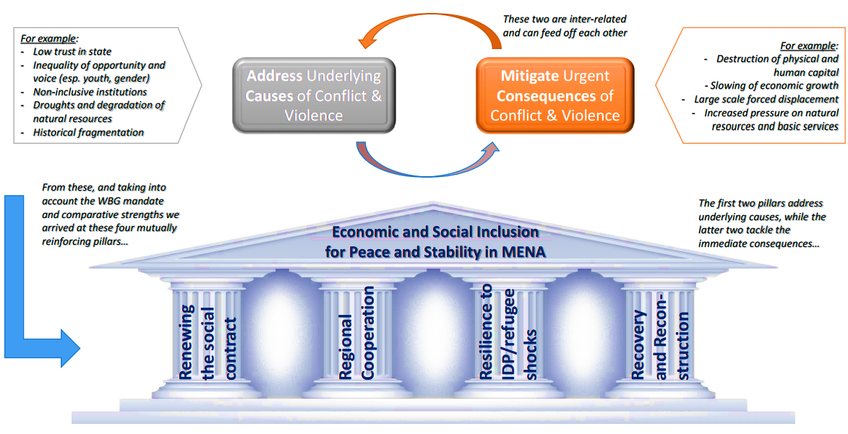
World Bank Strategy For MENA

Slide 38
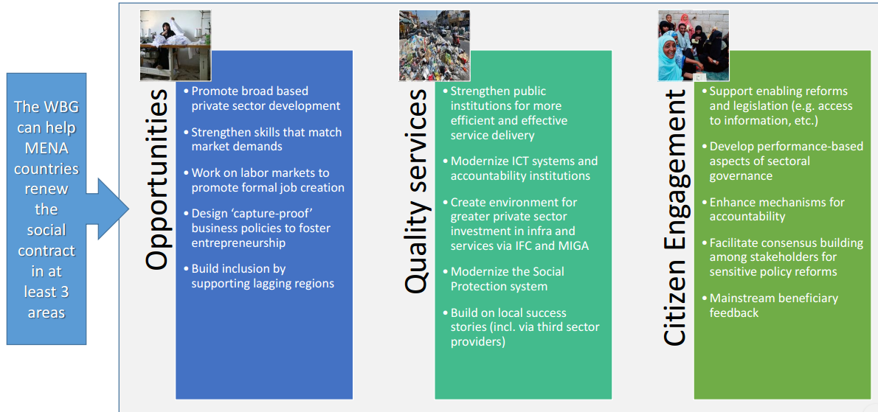
MENA Strategy: the First Pillar
Improving Governance and Accountability

Slide 39
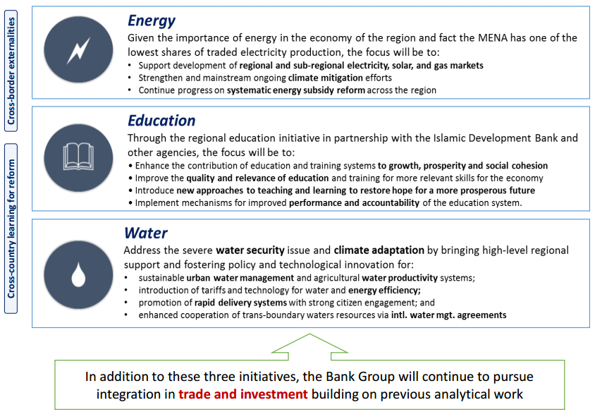
MENA Strategy: the First Pillar
Regional Integration

Slide 40
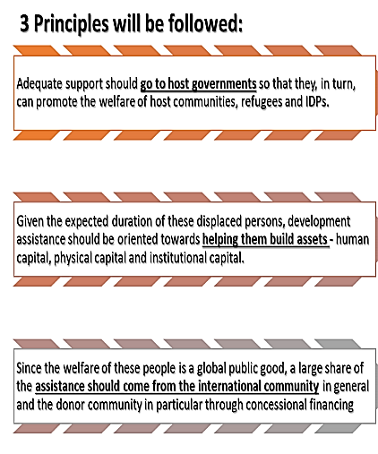
MENA Strategy: the Second Pillar
Resilience to shocks of refugees and IDPs & Recovery and Reconstruction

Slide 41
Thank You
Mahmoud Mohieldin,
SVP

